Slide 1

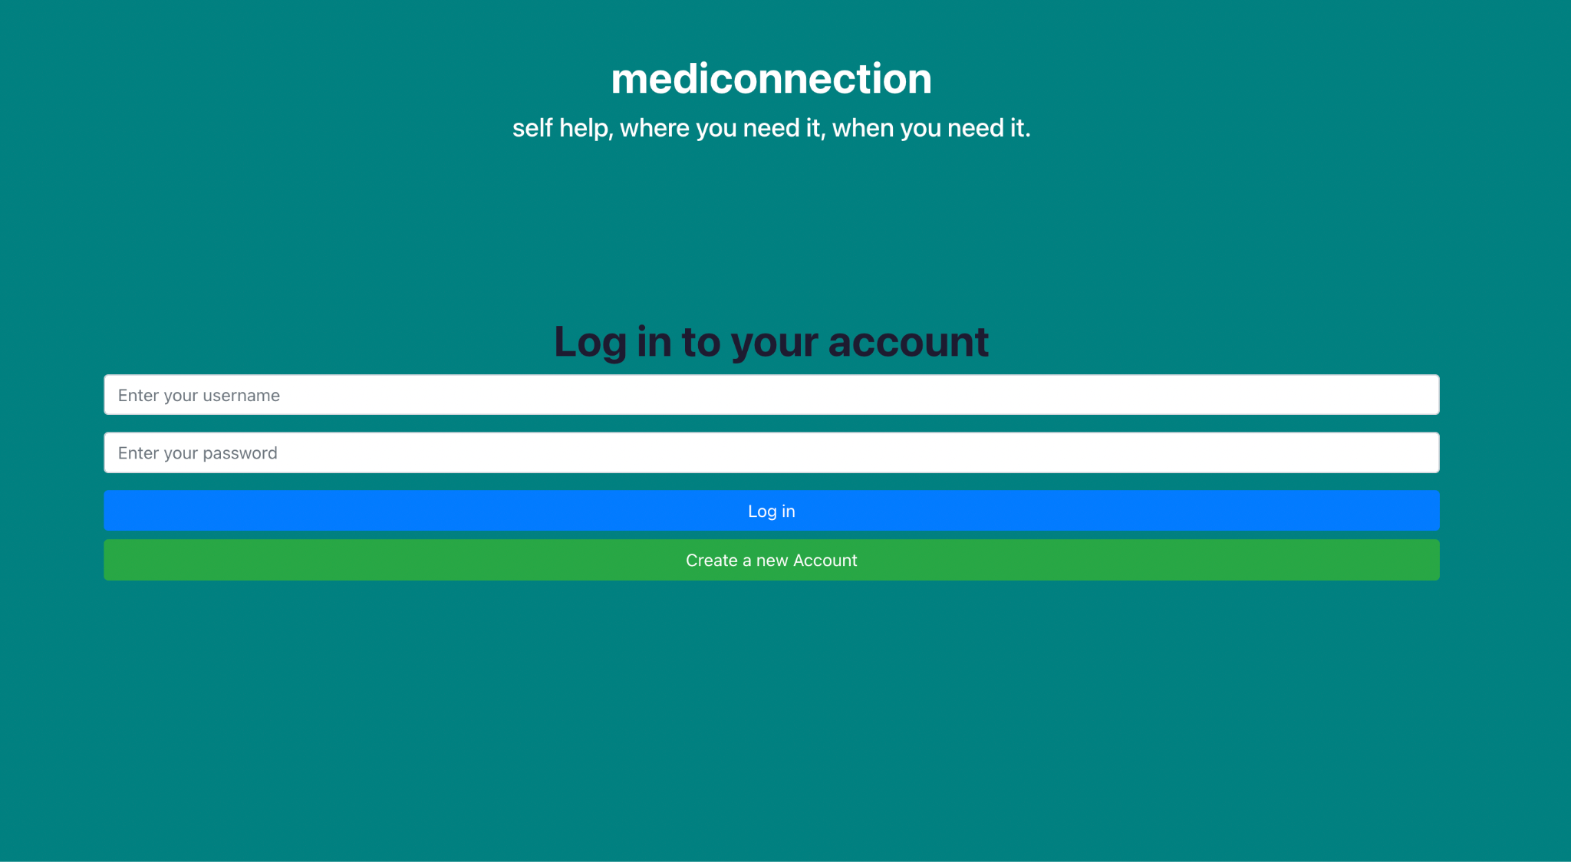
MediConnection
Problem statement and
solution proposal

Slide 2
Outline
Problem Statement
Motivation
Solution
Implementation
Demo

Slide 3
The Problem

Slide 4
Problem statement
There is a need for a solution that allows patients and healthcare providers to connect remotely, enabling easier access to medical advice, improved communication, recommendations, medication tracking, and prescriptions without in-person visits.

Slide 5
The Motivation

Slide 6
Motivation
To enhance the efficiency and convenience of healthcare services by enabling remote access to medical care and improved patient care through a mobile application

Slide 7
Solution Proposal
Notes:
The problem Mediconnection is trying to solve is to provide access to healthcare anytime and anywhere through telemedicine services. The proposed solution to this problem, mainly in terms of system architecture/models, is the development of a web application that can connect patients with licensed healthcare providers in real-time, allowing them to access medical advice, recommendations, and prescriptions without the need for in-person visits.

Slide 8
Information Gathering
Interviews:
one on one interviews with students and healthcare professionals
Questionnaires:
list of questions designed in google forms

Slide 9
Questionnaire
Section 1: General Information
1.1 Please provide your name, title, and organization:
1.2 What is the size of your organization (number of employees)?
1.3 What is the primary function of your organization within the healthcare industry?
Section 2: Communication
2.1 What communication channels do you currently use to interact with patients (e.g., phone, email, text messaging, mobile app)?
2.2 Are there any specific communication features you would like to see in the software (e.g., secure messaging, video conferencing)?
2.3 What types of communication do you want to facilitate between healthcare providers and patients (e.g., appointment reminders, test results, treatment updates)?
2.4 What types of communication do you want to facilitate between healthcare providers (e.g., consultation, referrals, case management)?
Section 3: Appointment Scheduling
3.1 What are the key features you require for appointment scheduling (e.g., online booking, automated reminders, appointment rescheduling)?
3.2 Do you require integration with any existing scheduling or calendar systems?
3.3 What are your preferred methods for patients to request, change, or cancel appointments?
3.4 Do you have any specific requirements for managing appointment waitlists or prioritizing urgent cases?
Section 4: Medication Tracking
4.1 What specific features do you require for medication tracking (e.g., prescription management, refill reminders, dosage tracking)?
4.2 Do you require integration with any existing electronic prescription systems or pharmacy management systems?
4.3 What types of medication-related alerts or notifications do you want to send to patients and/or healthcare providers?
4.4 How do you want patients to report medication adherence or any side effects experienced?

Slide 10
To achieve this, the following system architecture/models can be implemented:
Client-Server Architecture
Real-time Communication
Security and Privacy
Notes:
To achieve this, the following system architecture/models can be implemented:
Client-Server Architecture: The client-side of the system is developed using modern web development framework React. The server-side of the system is developed using Node.js, which is a popular runtime environment for building scalable and high-performance server-side applications. The server can handle requests from clients and perform the necessary computations and data processing to provide healthcare services. This architecture enables seamless communication between the client and server, allowing patients to access healthcare services anytime and anywhere.
This is important to allow for the booking an appointment process. When a patient wants to book an appointment with a healthcare provider, they make a request to the server, which then processes the request and schedules the appointment. The server-side of the system can communicate with the database to check for the availability of the healthcare provider, and also manage the scheduling of appointments. Once the appointment is scheduled, the server-side can communicate with the client-side of the system to provide confirmation of the appointment booking. The client-side of the system can then display the appointment booking details to the patient, and also provide any additional information they may need, such as the date and time of the appointment, the location, and any other relevant details.
Real-time Communication: The system can leverage real-time communication technologies such as WebSockets to provide instant messaging. WebSockets are a protocol that provides a communication channel between the client-side and server-side of the system. This means that once the WebSocket connection is established, the server-side and client-side can communicate with each other in real-time without the need for repeated requests and responses. This will allow patients to communicate with healthcare providers in real-time, enabling them to get the medical attention they need, no matter where they are.
Security and Privacy: As the system will be handling sensitive patient information, it is important to ensure that it is secure, including encryption, where there is a login page to access your account to book appointments and contact physicians.
*APIs (Application Programming Interfaces) are a set of protocols, routines, and tools that allow different software applications to communicate with each other. An API defines how the software components should interact with each other, enabling seamless integration and communication between different systems.
*React is a front-end JavaScript library for building user interfaces, while Node.js is a back-end runtime environment for building scalable and high-performance server-side applications. In the context of Medicus, React is used for developing the client-side of the system, while Node.js is used for developing the server-side of the system. This follows a common pattern in web development where React is used for the presentation layer and Node.js is used for the application logic and data management layer. The combination of React and Node.js enables developers to build full-stack web applications using a single programming language (JavaScript) and leverage the benefits of both client-side and server-side development.

Slide 11
Why it’s better than existing solutions?
Convenience
Quick Appointments
Real-time Communication
Notes:
MediConnection offers several advantages over existing solutions in the telemedicine industry. Here are some reasons why Medicus is better than existing solutions:
Convenience: Medicus provides patients with easy access to healthcare services anytime and anywhere. Patients can access medical advice, recommendations, and prescriptions without the need for in-person visits. This is especially convenient for patients who live in remote areas or have mobility issues.
Quick Appointments: Medicus provides a streamlined appointment booking system, which allows patients to quickly schedule appointments with licensed healthcare providers. This reduces the waiting time for patients and allows them to receive timely medical attention.
Real-time Communication: Medicus provides real-time communication services, that enable patients to communicate with healthcare providers in real-time. This allows for quick diagnosis and treatment recommendations, without the need for in-person visits.

Slide 12
First, why the MERN stack?
Deciding choice of development environment
The MERN stack is a popular combination of technologies used for building web applications.
Why our choice?
It allowed us to use Full-Stack JavaScript from frontend to backend.
This made us more efficient by reducing our learning curves since we all had some experience using JavaScript.
The MERN stack has a large and active community of developers who contribute to open-source projects and provide support through tutorials, and other resources.
1
-Framework Choices

Slide 13
CONSTRUCTION
-Viewing through the lens of major use cases
Notes:
The problem Mediconnection is trying to solve is to provide access to healthcare anytime and anywhere through telemedicine services. The proposed solution to this problem, mainly in terms of system architecture/models, is the development of a web application that can connect patients with licensed healthcare providers in real-time, allowing them to access medical advice, recommendations, and prescriptions without the need for in-person visits.

Slide 14
Tackling Communication
The Chat System
Real-time Physician/Patient Chat
Chat System works like regular messaging apps like whatsApp, albeit, trimmed to a patient and physician with an appointment between them.
Relevant database Schemas used are the Chat and Message databases.
A chat object stores the idea of what a chat is, and every object has a chat_Id.
A chat has a bunch of messages that are linked to it through its id.
Once a route to a chat is triggered, we search the message database for all messages linked to that chat, and display them in order of their timestamps and who sent what.
History saved for future logins.
-Major Use Case
-Priority: High
-Primary Stakeholder: Patient and Doctor
-Secondary Stakeholder: Patient and Doctor

Slide 15
Handling Searches
The Search functionality
Patient and Physician Search
Searching was the trickiest and one of the most difficult parts of the project.
We aimed to make the search responsive (we wanted entries to be queried as soon as they changed).
Also we wanted to be able to get search suggestion so far as the entry is an attribute of what is being searched.
So what we did here was to accept the entry as a placeholder for the string attributes of say a Physician.
So in running through the database, we do not only check the entry against usernames, but also other attributes like specialization, etc.
This made the search quite slower and we hope to make some changes in the future.
-Major Use Case
-Priority: High
-Primary Stakeholder: Patient and Doctor
-Secondary Stakeholder: Patient and Doctor

Slide 16
Limiting in-person Scheduling
The Appointment booking system.
Appointment Booking Flow
Patients request for appointments in the system.
A patient first searches for a physician in the hospital system and selects a service offered by the physician.
The patient is then prompted to enter the details for the appointment they wish to book: date, time, etc.
After this, the system uses the entered details to create an appointment object which is later sent to the Physician for approval/rejection.
After an appointment request has been sent, the can view the list of requests that have been sent and accept or reject them.
Acceptance of request opens up chat and medication tabs for the parties.
Main hurdle was data storage/fetch.
-Major Use Case
-Priority: High
-Primary Stakeholder: Patient
-Secondary Stakeholder: Doctor

Slide 17
Don’t Forget Your medications
Access Medication
Access Medication Flow
Patient clicks on"Appointments" on their dashboard
Systems displays all appointments associated to the user
Patient clicks on a particular appointment
Patient clicks on Medication tab
System checks if there are medications prescribed for
Depending on the the previous situation, the system either shows a empty catalogue of medications or shows list of medications and their dosage
-Major Use Case
-Priority: High
-Primary Stakeholder: Patient
-Secondary Stakeholder: Doctor

Slide 18
Don’t Forget Your medications
Medication Tracking
Medication Alert System
One main goal of ours was to integrate a calendar API once a medication had been added by a doctor for a patient in an appointment.
The dosage and medication names were supposed to be taken and used in tandem with the daily dosage frequency to generate a calendar file (ics) which could be downloaded by a patient to keep themselves alerted as to when to take their medications and how much quantity they should take.
Unfortunately, we did not manage to implement the .ics file generation after being able to add medications.
-The failed Use Case

Slide 19
TESTING
Notes:
The problem Mediconnection is trying to solve is to provide access to healthcare anytime and anywhere through telemedicine services. The proposed solution to this problem, mainly in terms of system architecture/models, is the development of a web application that can connect patients with licensed healthcare providers in real-time, allowing them to access medical advice, recommendations, and prescriptions without the need for in-person visits.

Slide 20
Questions?

